Slide 1

3 MONTHS CM ANALYSIS (DEC’18 TO FEB’19) & FEEDBACK REPORT
Presented By,
Sharmin Akther Diba
Central IE & Planning Department
http://ordnur.com

Slide 2

DEC’18 TO FEB’19 ALL UNIT DPR SUMMARY
Total Sewing quantity : 14.28 M PCs
Average MKT SMV/PCs : 8.93
Average Sew SMV/PCs : 8.72
Average Layout MP(OP+HLP) : 36
Average Used MP(OP+HLP) : 38
Average Expected Efficiency : 44.93%
Average Achieved Efficiency : 42.54%
Average MKT CM/DZn : $8.60
Average PLAN TGT CM/DZn : $11.72
Average SEW CM/DZn (USED) : $13.52
MKT Vs Plan Tgt CM Variance : $3933.0123 M
MKT Vs Used CM Variance : $6192.5275 M
Plan Tgt Vs Used CM Variance : $2259.5151 M
Data Source
Data based on Daily Production Report
CM based on Finance dept. report
CPM based on Finance dept. data (.0358 $)
CM Variance Report (Dec'18 to Feb'19).xlsx

Slide 3

DEC’18 TO FEB’19 UNIT-01 DPR SUMMARY
Total Sewing quantity : 5.49 M PCs
Average MKT SMV : 8.44
Average Sew SMV : 8.26
Average Layout MP(OP+HLP) : 34
Average Used MP(OP+HLP) : 42
Average Expected Efficiency : 48.61%
Average Achieved Efficiency : 35.74%
Average MKT CM/DZn : $8.20
Average PLAN TGT CM/DZn : $9.62
Average SEW CM/DZn (USED) : $14.61
MKT Vs Plan Tgt CM Variance : $228.0043 M
MKT Vs Used CM Variance : $1024.7610 M
Plan Tgt Vs Used CM Variance : $796.7567M

Slide 4

DEC’18 TO FEB’19 UNIT-02 DPR SUMMARY
Total Sewing quantity : 4.14 M PCs
Average MKT SMV/PCs : 9.30
Average Sew SMV/PCs : 9.05
Average Layout MP(OP+HLP) : 37
Average Used MP(OP+HLP) : 33
Average Expected Efficiency : 43.08%
Average Achieved Efficiency : 52.08%
Average MKT CM/DZn : $8.68
Average PLAN TGT CM/DZn : $12.84
Average SEW CM/DZn (USED) : $9.87
MKT Vs Plan Tgt CM Variance : $515.6169 M
MKT Vs Used CM Variance : $147. 5045 M
Plan Tgt Vs Used CM Variance : $368.1123 M

Slide 5
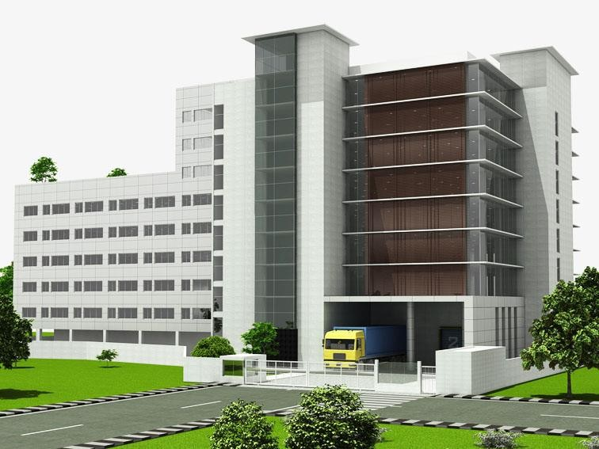
DEC’18 TO FEB’19 UNIT-03 DPR SUMMARY
Total Sewing quantity : 4.64 M PCs
Average MKT SMV/PCs : 9.18
Average Sew SMV/PCs : 8.97
Average Layout MP(OP+HLP) : 37
Average Used MP(OP+HLP) : 39
Average Expected Efficiency : 43.16%
Average Achieved Efficiency : 39.51%
Average MKT CM/DZn : $8.92
Average PLAN TGT CM/DZn : $12.68
Average SEW CM/DZn (USED) : $16.19
MKT Vs Plan Tgt CM Variance : $508.2320 M
MKT Vs Used CM Variance : $982.4476 M
Plan Tgt Vs Used Tgt CM Variance : $474.2156 M

Slide 6

CM VARIANCE

Slide 7
CM loss in Marketing, less than plan target CM
CM loss in production, less than Marketing CM
CM loss in production, less than plan target CM
Overall CM loss

Slide 10

BUYER WISE CM VARIANCE

Slide 12
BUYER | Avg Plan Target CM/Dzn | Avg Marketing CM/Dzn | CM Variance | Remarks
H&M | $ 8.13 | $ 7.09 | $ (1.04) | Loss
GU(MARUBENI) | $ 10.04 | $ 8.66 | $ (1.39) | Loss
NEXT SOURCING | $ 14.46 | $ 8.77 | $ (5.69) | Loss
CALZEDONIA | $ 7.11 | $ 6.25 | $ (0.86) | Loss
BLANKS PLUS | $ 10.01 | $ 6.27 | $ (3.74) | Loss
CASAMODA | $ 32.90 | $ 16.00 | $ (16.90) | Loss
GUESS (NEWTIMES) | $ 13.26 | $ 9.40 | $ (3.85) | Loss
JENNYFER | $ 9.62 | $ 8.87 | $ (0.75) | Loss
LERROS | $ 12.51 | $ 9.57 | $ (2.94) | Loss
OSTIN | $ 10.04 | $ 7.31 | $ (2.74) | Loss
PROMORORO | $ 10.11 | $ 11.03 | $ 0.92 | Gain
S'OLIVER | $ 17.75 | $ 14.30 | $ (3.45) | Loss
TOM TAILOR | $ 21.40 | $ 10.59 | $ (10.81) | Loss
VARNER | $ 10.88 | $ 7.39 | $ (3.48) | Loss

Slide 14
BUYER | Avg Marketing CM/Dzn | Avg Used CM/Dzn | CM Variance | Remarks
H&M | $ 7.09 | $ 14.76 | $ (7.67) | Loss
GU(MARUBENI) | $ 8.66 | $ 9.29 | $ (0.63) | Loss
NEXT SOURCING | $ 8.77 | $ 10.22 | $ (1.45) | Loss
CALZEDONIA | $ 6.25 | $ 8.34 | $ (2.09) | Loss
BLANKS PLUS | $ 6.27 | $ 12.37 | $ (6.10) | Loss
CASAMODA | $ 16.00 | $ 32.72 | $ (16.72) | Loss
GUESS (NEWTIMES) | $ 9.40 | $ 18.13 | $ (8.72) | Loss
JENNYFER | $ 8.87 | $ 12.42 | $ (3.55) | Loss
LERROS | $ 9.57 | $ 10.63 | $ (1.06) | Loss
OSTIN | $ 7.31 | $ 11.83 | $ (4.52) | Loss
PROMORORO | $ 11.03 | $ 13.64 | $ (2.61) | Loss
S'OLIVER | $ 14.30 | $ 26.08 | $ (11.79) | Loss
TOM TAILOR | $ 10.59 | $ 25.58 | $ (14.98) | Loss
VARNER | $ 7.39 | $ 13.82 | $ (6.43) | Loss

Slide 16
BUYER | Avg Plan Target CM/Dzn | Avg Used CM/Dzn | CM Variance | Remarks
H&M | $ 8.13 | $ 14.76 | $ (6.63) | Loss
GU(MARUBENI) | $ 10.04 | $ 9.29 | $ 0.76 | Gain
NEXT SOURCING | $ 14.46 | $ 10.22 | $ 4.24 | Gain
CALZEDONIA | $ 7.11 | $ 8.34 | $ (1.23) | Loss
BLANKS PLUS | $ 10.01 | $ 12.37 | $ (2.36) | Loss
CASAMODA | $ 32.90 | $ 32.72 | $ 0.18 | Gain
GUESS (NEWTIMES) | $ 13.26 | $ 18.13 | $ (4.87) | Loss
JENNYFER | $ 9.62 | $ 12.42 | $ (2.80) | Loss
LERROS | $ 12.51 | $ 10.63 | $ 1.88 | Gain
OSTIN | $ 10.04 | $ 11.83 | $ (1.78) | Loss
PROMORORO | $ 10.11 | $ 13.64 | $ (3.53) | Loss
S'OLIVER | $ 17.75 | $ 26.08 | $ (8.33) | Loss
TOM TAILOR | $ 21.40 | $ 25.58 | $ (4.17) | Loss
VARNER | $ 10.88 | $ 13.82 | $ (2.94) | Loss

Slide 17
Findings from Analysis
CM loss at Marketing $3,933.0123 [Dec’18-Feb’19]. Only Buyer ‘Promodoro’ Marketing CM gain $5.8259.
Avg Marketing SMV & Avg Sewing SMV difference 0.21 . SMV used in production less than Marketing, which is a positive fact to gain profit.
CM loss of Unit-01 & Unit-03 in production, use of more manpower than Marketing, achievement of less efficiency than Marketing are the reasons of loss in CM.
In Unit-02, efficiency gain (52.08%) is more than expected (43.08%) but used CM is more than Marketing & Less than Plan target CM. If There was no loss during Marketing, CM gain would be profitable.
Efficiency variation avg 2.40% than expected which results in total CM loss.

Slide 18
Feedback from Analysis
CM based target need to establish for profit gain in CM.
Capacity calculation/ projection should be followed by CM considering SMV, Manpower, Working hour, Efficiency as well as Quality.
CPM should be standardize/similar for all buyer & all units.

Slide 19
NECESSITY OF CM BASED TARGET SET-UP
Currently Garments profit calculation based on FOB. But in practical it is total performance of Textile, Fabric finishing, sewing, printing, embroidery, Garments finishing, logistics etc. & investors profit percentage, deficiency cost.
Profit calculation & evaluation will be equal for all unit.
CM based target can be used for other units like Textile, AOP, Finishing, Dyeing etc. to measure performance more precisely.

Slide 20
PRE-ACTIVITIES FOR CM BASED CAPACITY ALLOCATION which we want to do FOR future betterment(Cont.)
Production floor should be Industrial Engineering database controlled.
6S/7S Training & auditing system should be established for all employees of all department.
Floor IE must know operation breakdown, CM & Efficiency analysis.
Line balancing, workstation standardization, lean management training needed for IE & production people also.
No modification in Line layout (SMV, MP, M/C) will happen by approval of Corporate IE department.

Slide 21
PRE-ACTIVITIES FOR CM BASED CAPACITY ALLOCATION which we want to do FOR future betterment
Cutting section should be IE based CM calculation to improve efficiency & gain profit from Cut-make section.
Finishing section should be IE based CM calculation to improve efficiency & gain profit from make-trim section.
Textile sector should be IE based to reduce re-process & re-work. In long run it will gain more profit from textile sector.
Printing IE activities will be vast to CM based capacity allocate for making it more precise in profit gain & efficiency achievement.
Other production units need to Industrial Engineering controlled to achieve target efficiency & profit.

Slide 22
Positive outcome from proposed implementation ideas
There will be no CM loss during marketing stage. Use of similar CPM will leads marketing team to work for plant target CM wise order taking.
CM loss will not happen in production stage with proper manpower utilization, efficiency achievements, quality products by IE based production system.
CM profit is the core profit percentage of FOB & our factory profit margin will increase by proper implementation of IE based activity in every sector.

Slide 23

THANK YOU

